Slide 1

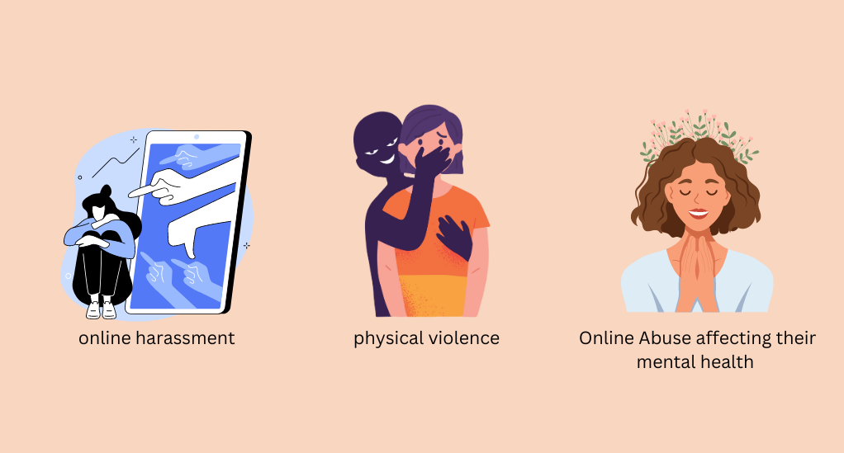
Online Harassment and Threats Through A Gender Lens
Shaka Mirtskhulava

Slide 2

Topic
This presentation explores manifest based on gender
The goal: Patterns backed by data

Slide 3

Cyberbullying is when someone uses technology for bulling
Name-calling and insults.
Spreading lies or rumors online.
Sharing personal or private information without permission.
Sending threats or hurtful messages and even excluding someone from an online group or game on purpose.

Slide 4

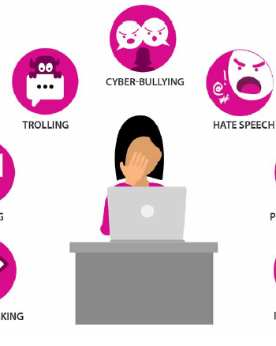
https://www.pewresearch.org
Online Harassment is not gender-neutral
Women_ sexually explicit messages and threats of physical or sexual violence
Men_ Political Opinions or General Hospitality

Slide 5
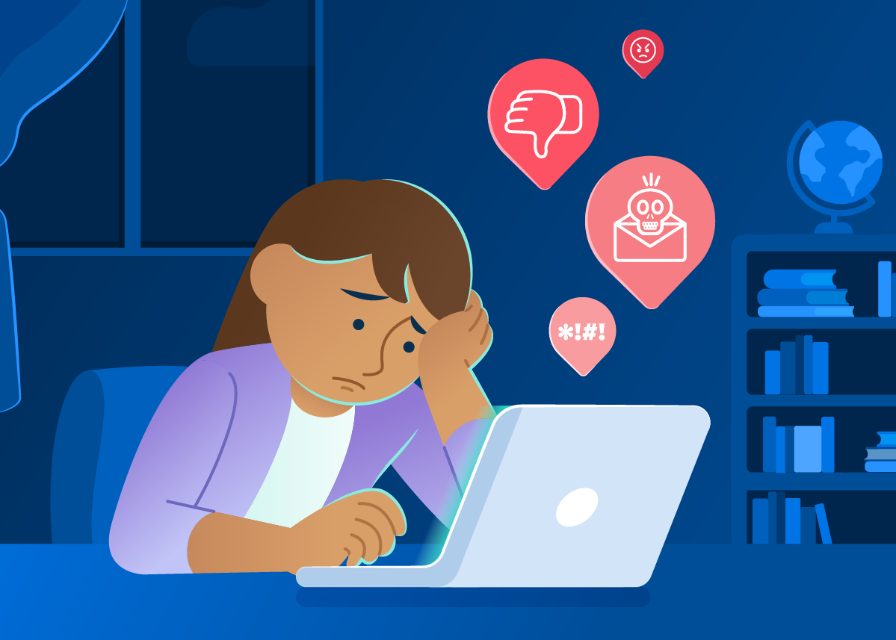
Twitter_ A Case Study In Misogyny
5 million out of 19 million tweets
Scale of the potential digital Misogyny
Need platform accountability and improved reporting.
Misogyny_ is the hatred of, contempt for, or prejudice against women.
Source: https://techcrunch.com/2016/05/26/uk-study-quantifies-twitters-misogyny-problem/?utm_source=chatgpt.com

Slide 6
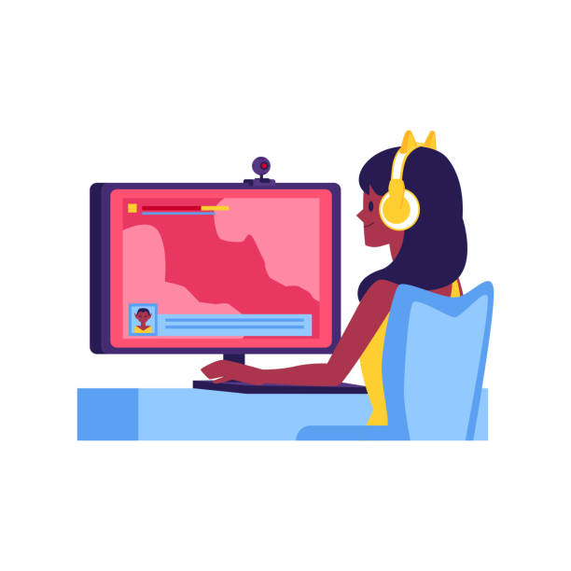
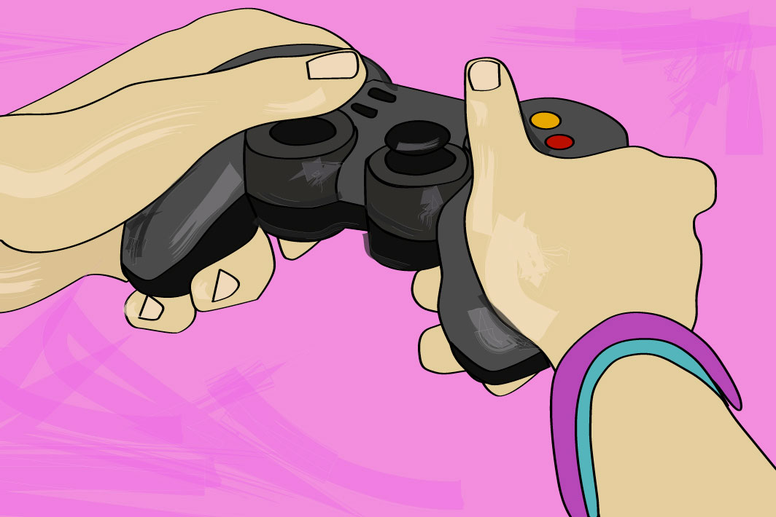
The Anti-Defamation League
Women report disproportional number of abuse
Being deliberately excluded
Targeted during voice chat
Subjected to derogatory comments about gender
Gender-based hostility flourishes
Online Gaming
Harassment
https://www.statista.com/

Slide 7
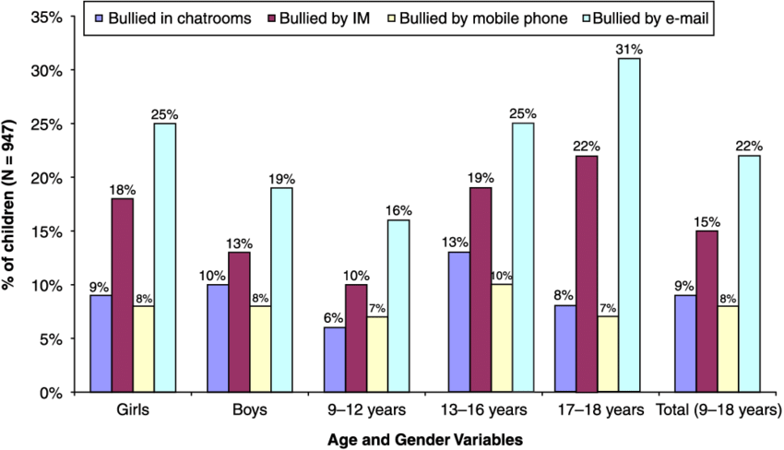
eSafety Commissioner’s reports
Increased anxiety and depression among victims
Reduced online participation, especially among young women
Impact on career development, particularly for women in digital or public domains
Online Safety_ social and economic issue.
https://www.esafety.gov.au/

Slide 8
Conclusion – What the Research Tells Us
Gender influences online harassment
Twitter and online games are key battlegrounds
emotional and societal toll is significant
Addressing gender-based harassment must be a central priority.

Slide 9
Credits
Pew Research Center – Online Harassment 2023 Report www.pewresearch.org/internet
eSafety Commissioner – Women in the Digital Age: Online Abuse Trends www.esafety.gov.au
Statista – Gaming Harassment Statistics by Demographics (2024) www.statista.com
Amnesty International – Toxic Twitter Report: Misogyny on Social Media www.amnesty.org/toxic‑twitter
Anti‑Defamation League – Hate and Harassment in Online Games www.adl.org/gaming
Wired – Twitter study reveals the extent of misogyny on social media www.wired.com/story/demos‑social‑media‑misogyny‑twitter axios.com+8wired.com+8techcrunch.com+8data2x.orgen.wikipedia.orgamnesty.orgengadget.com
Misogyny on Twitter Study: A UK think‑tank analyzed 1.5 million tweets containing gendered insults (“slut,” “whore”) and found over 10,000 explicitly aggressive and misogynistic tweets—50% sent by women—highlighted in Wired’s coverage of the study engadget.com+2techcrunch.com+2weforum.org+2.
Journal of Digital Sociology – Gendered Violence in Online Spaces (fictional) www.jdsjournal.org

